Slide 1
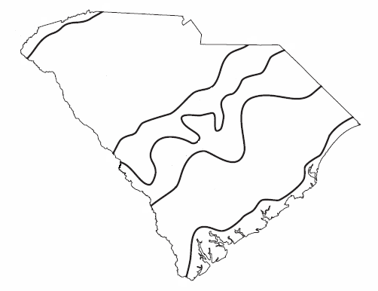

Let’s Travel Through the Regions of South Carolina!

Slide 2
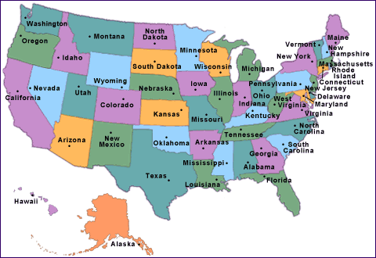
Where is South Carolina?
United States of America
Here we are! South Carolina borders the Atlantic Ocean.

Slide 3
Why is the state divided into regions?
South Carolina is divided into different regions or sections because different areas of the state are made up of specific physical features and human features.

Slide 4
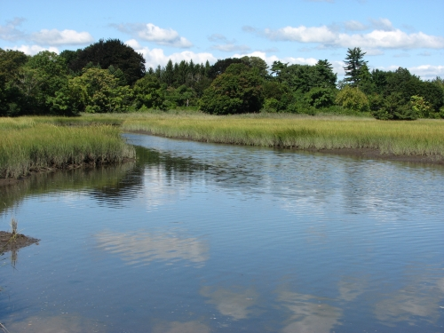
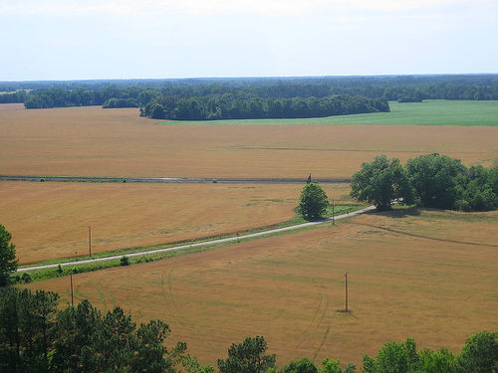
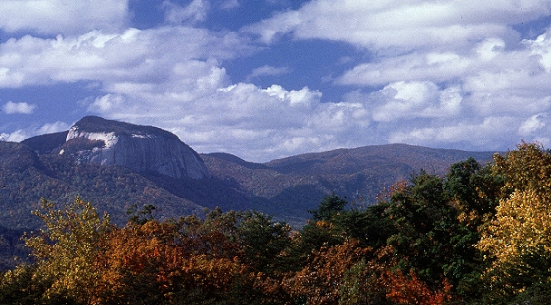
What are physical features?
Physical features include the various landforms in the region. These landforms can include marshes, plains, hills, and mountains to name a few.

Slide 5
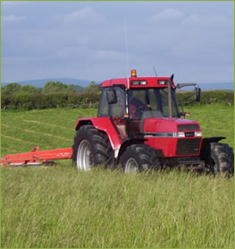

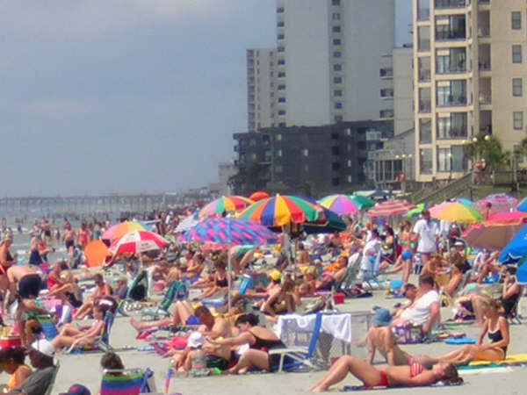
What are human features?
Human features include how humans use the land for resources and recreation.

Slide 6
Physical and human features divide South Carolina into these six regions:
Coastal Zone
Outer Coastal Plain
Inner Coastal Plain
Sandhills
Piedmont
Blue Ridge

Slide 7
Let’s Begin Our Travel with Region Workstations!
You will visit each region workstation to learn . . .
  where each region is located,
  the physical features of the region, and
  the human features of the region.

Slide 8

In each workstation folder you will find . . .
A map showing the region
Photographs of the region
An information sheet
A workstation task card
A student page where you will record your discoveries
An exit slip for your reflections and new learning

Slide 9
Enjoy Your Travel Through the Regions of South Carolina!

Slide 10
Let’s Review Our State’s Six Regions

Slide 11
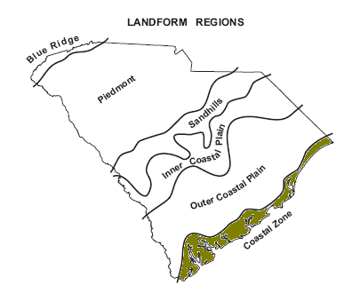
Let’s Start at Home: Coastal Zone
The Coastal Zone is where we live. This is the region where the beaches and barrier islands are located. It borders the Atlantic Ocean.
Millions of people come to this region for vacation because of all the wonderful things to do here.
Tourism is a big industry here.
Notes:
11

Slide 12
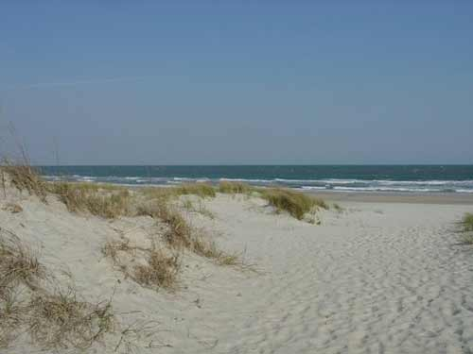
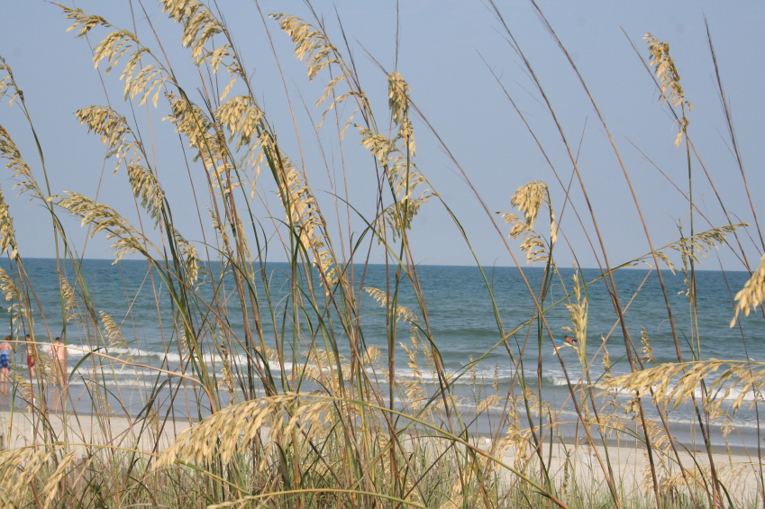
Coastal Zone
Physical Features
Borders the Atlantic Ocean
Beaches
Barrier islands
Natural harbors
Marshes

Slide 13
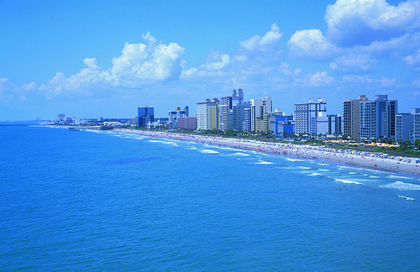

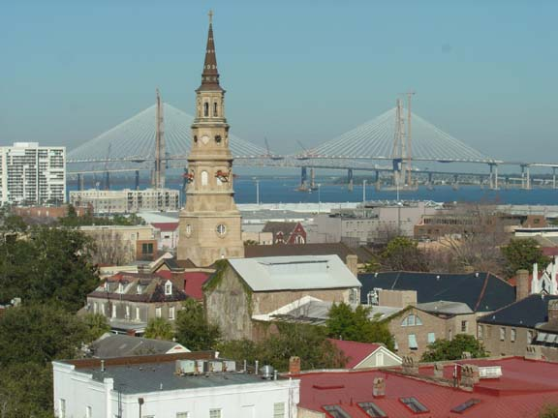
Coastal Zone
Human Features
Boating
Fishing
Tourism including
  Beach activities,
  Golf, and
  Historic places

Slide 14
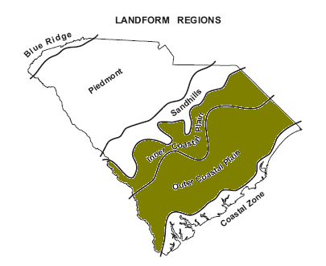
Our Second and Third Stops:
Inner and Outer Coastal Plains
The outer Coastal Plain, next to the Coastal Zone, is flat land close to the shore and is full of swamps and marshes and rivers that flow down and into the ocean.
The Inner Coastal Plain is a little hilly, and this soil is very rich, perfect for farming.
Notes:
14

Slide 15
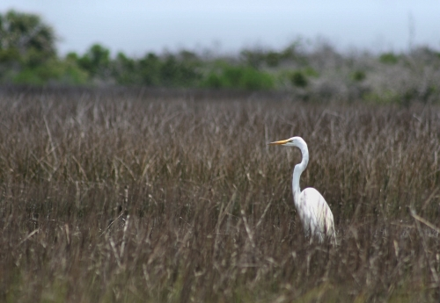
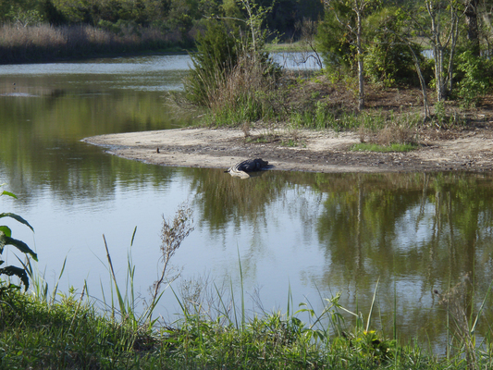
Outer Coastal Plains
Physical Features
Flat land
Swamps
Marshes

Slide 16
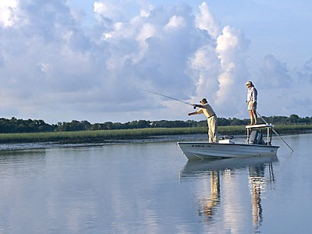
Outer Coastal Plains
Human Features
Fishing
Boating
Golfing

Slide 17
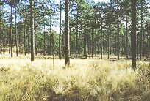
Inner Coastal Plains
Physical Features
Gradual hills
Rich, well-drained soil
Large trees

Slide 18
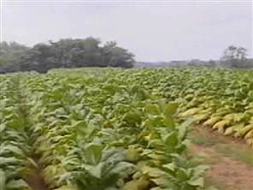
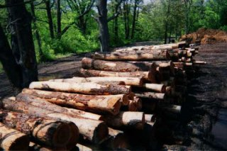
Inner Coastal Plains
Human Features
Farming
Timbering

Slide 19
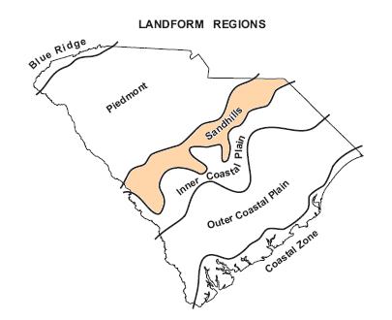
Our Fourth Stop: Sandhills Region
Much of the soil in the Sandhills is made up of just that, sand.
Millions and millions of years ago the ocean covered much of this region making it the shore.
When the water receded it left a hilly, sandy landscape just like you would find near a beach.
Notes:
19

Slide 20
Our Fourth Stop:
Sandhills Region
This regions follows the fall zone of the state’s rivers.
The drop in elevation creates rapids.
Columbia, our state capital, is in the Sandhills.
Notes:
20

Slide 21
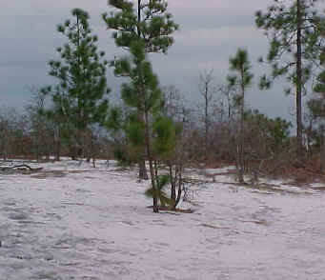
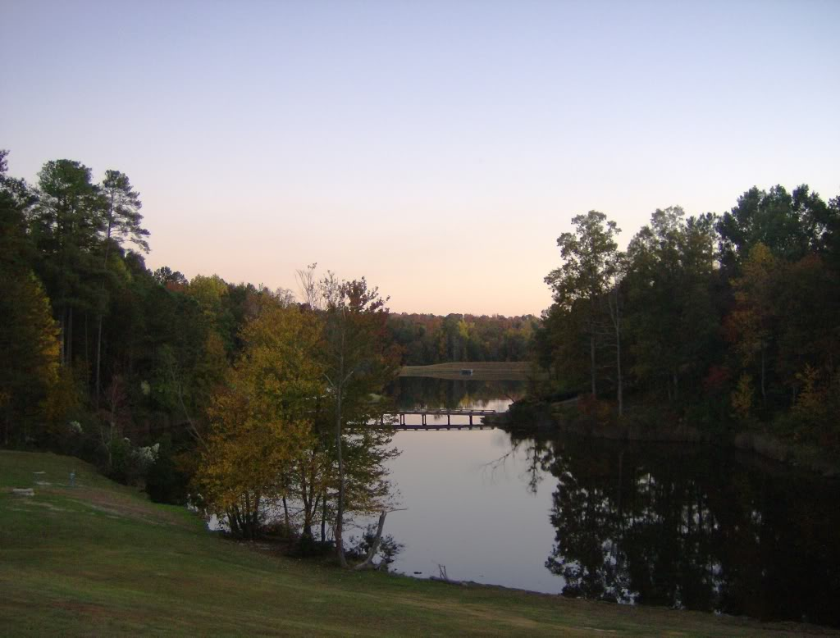
Sandhills Region
Physical Features
Flat land
Sandy soil
Follows fall zone where state’s rivers drop

Slide 22
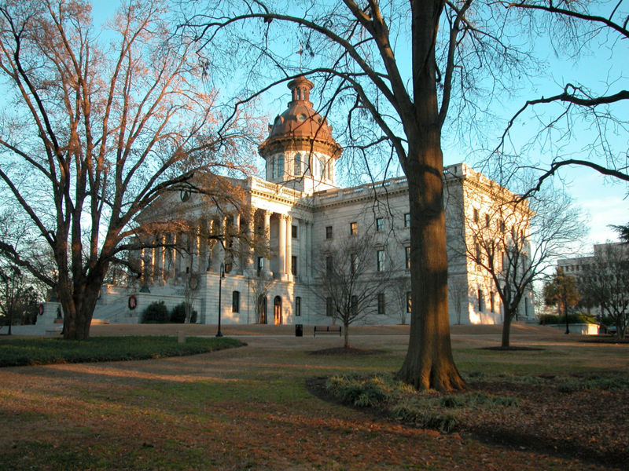
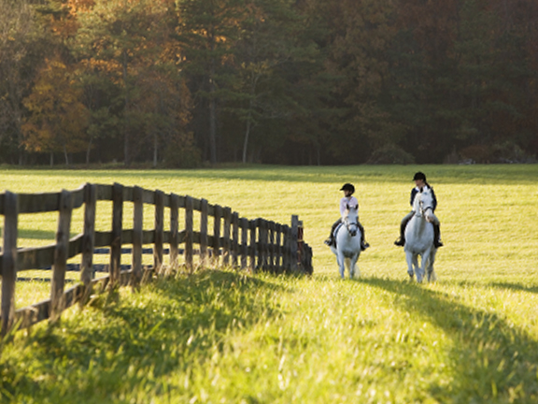
Sandhills Region
Human Features
Columbia, state capital
Horse farms
Peach farms

Slide 23
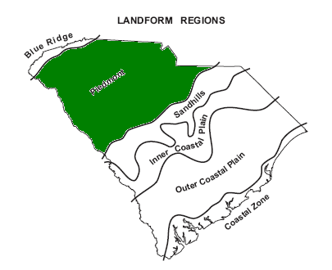
Our Next Stop:
Piedmont Region
Piedmont means “foot of the mountain” which would make the Piedmont region right next to the Blue Ridge mountains.
It has rolling hills and valleys.
It’s soil is red clay.
The Piedmont region is the largest of South Carolina’s 6 regions.
Notes:
23

Slide 24
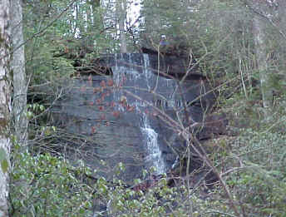
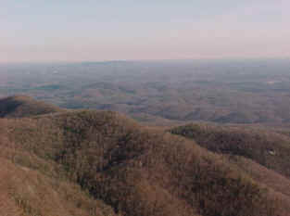
Piedmont Region
Physical Features
Foothills of the mountains
Many rolling hills and valleys
Red clay
Waterfalls and swift rivers

Slide 25

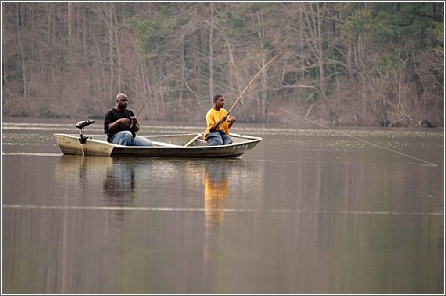
Piedmont Region
Human Features
Factories
Fishing
Boating

Slide 26
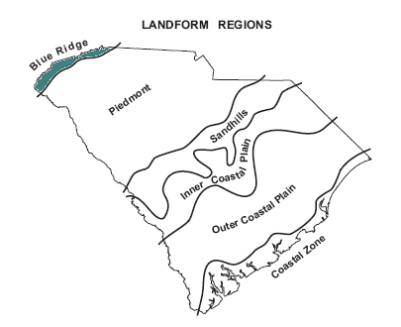
Our Last Stop:
Blue Ridge Region
The Blue Ridge Region of South Carolina is the smallest of the regions.
There are many hardwood forests and mountains to hike and streams to go white water rafting.
This region is home to the only mountain range in South Carolina- the Blue Ridge Mountains.
Notes:
26

Slide 27
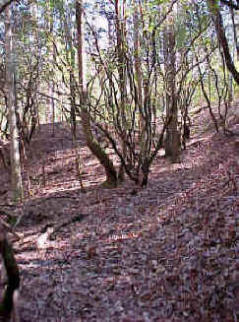
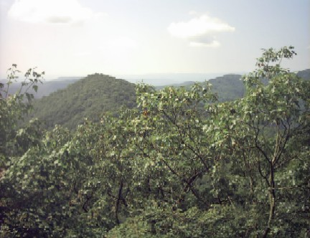
Blue Ridge Region
Physical Features
Many hardwood forests
Streams
Waterfalls

Slide 28
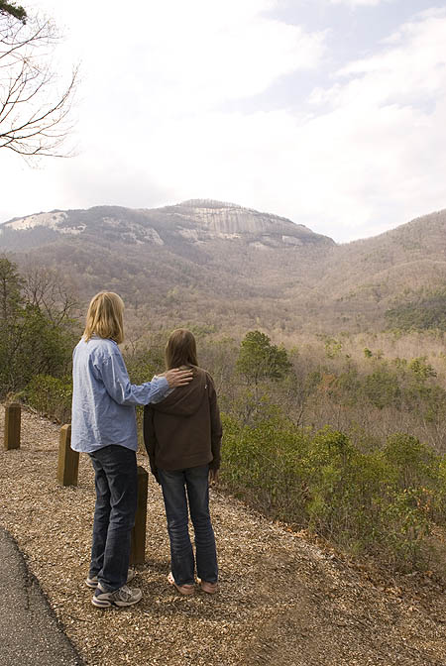
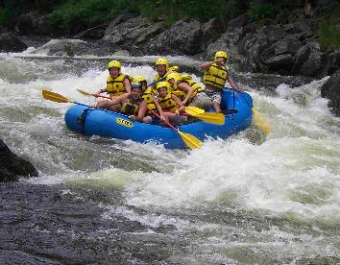
Blue Ridge Region
Human Features
Hiking
White-water rafting

Slide 29
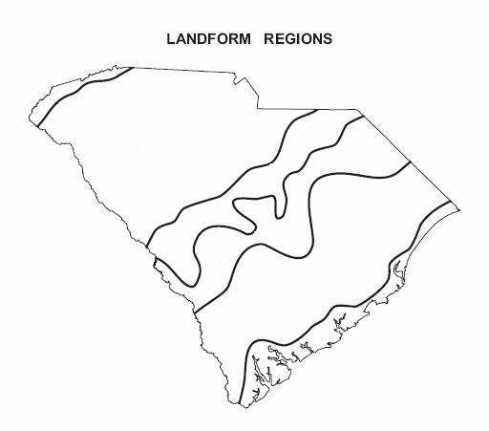
South Carolina Regions
Up Country- Piedmont and Blue Ridge
Midlands- Sandhills and Inner Coastal Plain
Low Country- Outer Coastal Plain and Coastal Zone
Notes:
29

Slide 30
Remember . . .
There are six landform regions in South Carolina:
Coastal Zone
Outer Coastal Plain
Inner Coastal Plain
Sandhills
Piedmont
Blue Ridge

Slide 31
South Carolina’s Six Regions Song
South Carolina it has 6 regions,
Come visit them and have some fun!
Start at the beach and go up to the mountains,
We’re gonna learn each and every one.
Click on the state map to watch the video!

Slide 32
The COASTAL ZONE,
Beside the Atlantic Ocean makes its home.
Find a seashell or a little fish bone,
In the COASTAL ZONE.

Slide 33
The INNER COASTAL PLAIN oh it’s very clear,
Lots of sandy soil and farming here,
Millions of years ago the ocean was near,
In the INNER COASTAL PLAIN, my dear!

Slide 34
The OUTER COASTAL PLAIN,
Some big old swamps and flat terrain,
Many rivers from the ocean drain,
Through the OUTER COASTAL PLAIN.

Slide 35
South Carolina it has 6 regions,
Come visit them and have some fun!
Start at the beach and go up to the mountains,
We’re gonna learn each and every one.

Slide 36
The SANDHILLS, a great place to be,
Columbia, the capital, and USC,
Aiken and Camden lots of horses you see,
In the SANDHILLS yes-sir-ee.

Slide 37
Rock Hill so close to Carowinds (whoo),
Spartanburg and Greenville lots of factories my friend,
In the PIEDMONT, where the big hills begin.

Slide 38
The BLUE RIDGE is the last region,
The Appalachian Mountains are so much fun!
Sassafras Mountain is the tallest one,
In the BLUE RIDGE region.

Slide 39
South Carolina it has 6 regions,
Come visit them and have some fun!
Start at the beach and go up to the mountains,
We’re gonna learn each and every one.
The COASTAL ZONE, the OUTER COASTAL PLAIN,
the INNER COASTAL PLAIN, the SANDHILLS,
the PIEDMONT, and BLUE RIDGE!
The end!

Slide 40
South Carolina Landform Regions Map
Our state is divided into regions. Can you remember them? We can.
B
p
B=Blue
P=Pencils
S=Scribble
I=Ink
O=Over
C=Crabs
S
I
O
C
Do you remember your 3rd grade South Carolina Landform Regions?

